Slide 1
GAN Project
Jack Colvin and Ayaan De Silva

Slide 2
Introduction
Driving Question: How Effectively can a General Adversarial Network (GAN) replicate galaxy morphology?
Process:
Development of a GAN model (Discriminator + Generator) trained on SDSS galaxy data
Analysis of GAN results using Sersic light profile fitting and radial color analysis of GAN results vs training sample
Morphological classification of galaxies using a simple shallow CNN model to assess our model’s potentially for replicating complex morphological features of galaxies

Slide 3
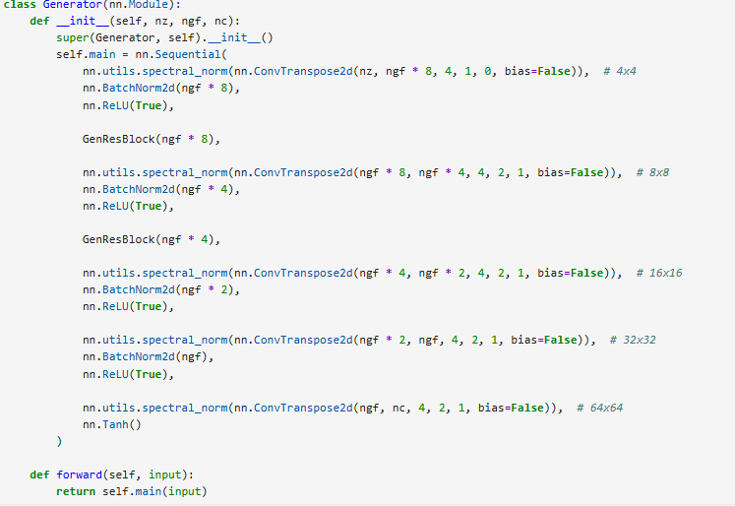
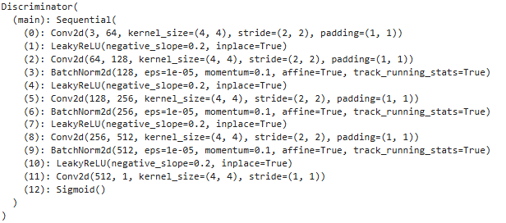
GAN Model Architecture
Generator:
Standard Generator Model based off of torch tutorial: 5 Conv2D layers using nn.sequential architecture
9.48M parameters: quite a deep/complex model
Output: 64x64x3 color image
.0002 Learning Rate
Discriminator:
Similar to Generator Model, 5 Conv2D layers using a sequential model
2.7M parameters, also a deep model
Input: 128x128x3 training image, outputs a feature array with 512 features
.00075 Learning Rate: smaller than generator to prevent overtraining

Slide 4





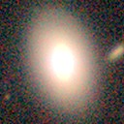
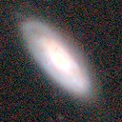
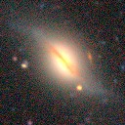
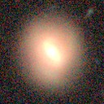
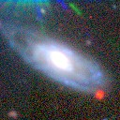




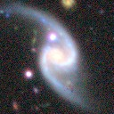
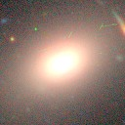
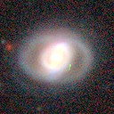
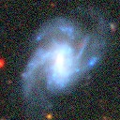
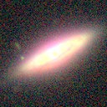





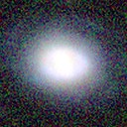
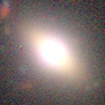
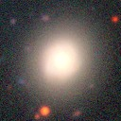
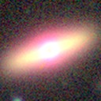
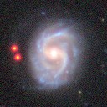





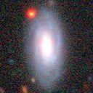
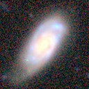
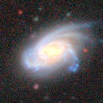
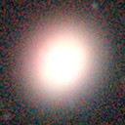
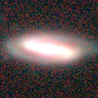
Gan Outputs vs Training Inputs (500 Epochs)
Example Gan Images:
Example Training Images:
Qualitatively, pretty good! GAN images lack definition and more complex features, but match general structure well overall!

Slide 5
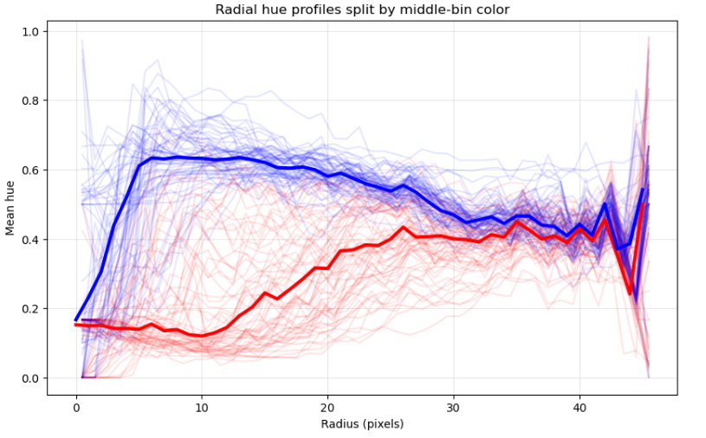
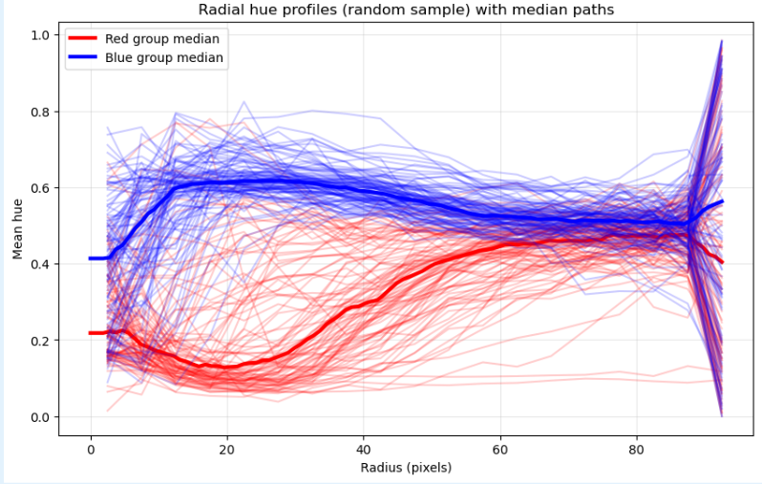
Quantitative Analysis: Radial Light Profile Binning by Color
Method:
Separated Images into 12-px wide radial bins
Measured average color in each bin from 0-1 (red-purple)
Plotted color curve for each galaxy in Gan output and a random sample from training Images
Results:
Both samples decomposed into a bluer set and a redder set of galaxies
Median curves matched very closely in training vs output: GAN performed well

Slide 6
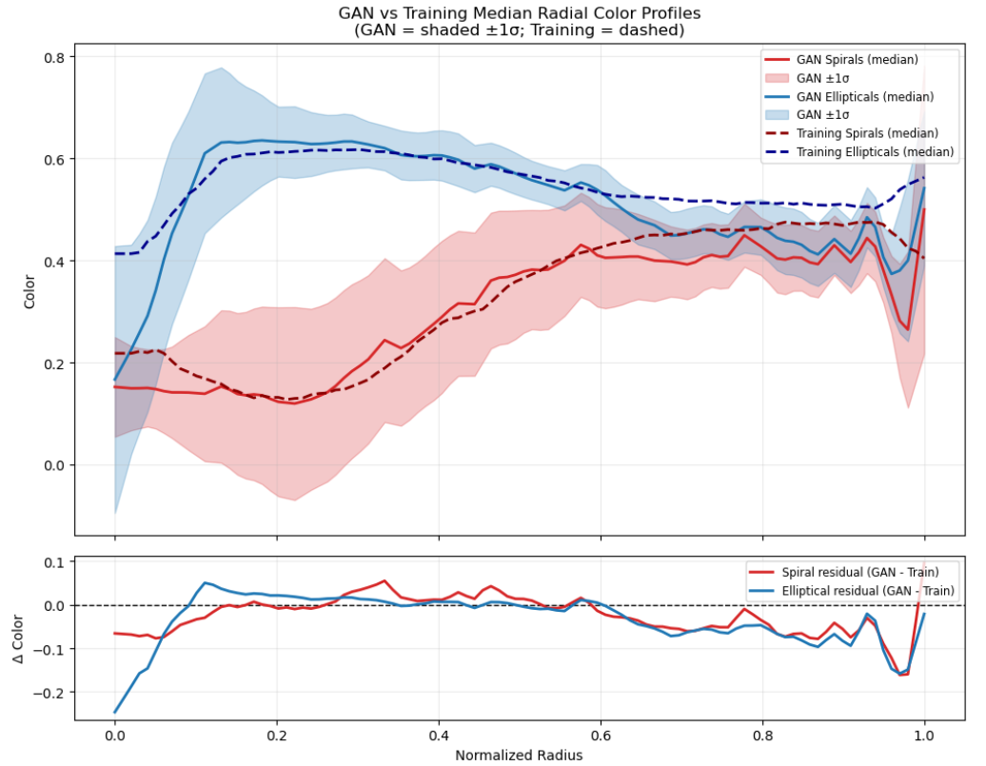
Radial Color Binning: Error Analysis
Qualitatively, the GAN median curves follow the training sample curves very closely
For the bluer and redder populations respectively, I obtained a reduced chi2 of .361 and .596.
These values indicate that the deviation of the training medians from each other were less than the intrinsic scatter of the points in each population, which suggests that the GAN reproduces general radial color trends well.

Slide 7
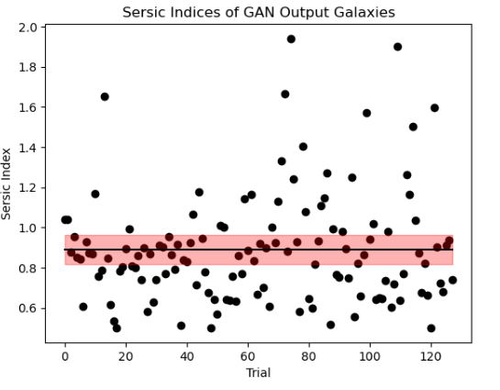
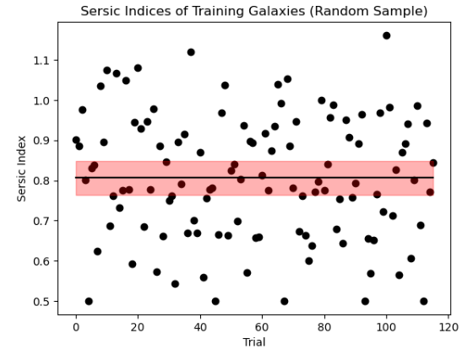
Quantitative Analysis: Sersic Profile Fitting
Method:
Fit each galaxy in both sets to a two component (disk+bulge), elliptical sersic profile
Measured and plotted scatter of sersic indices after cleaning values to reasonable ranges
Results:
Agreement between the means (means are between 3σ of each other)
GAN again quantitatively seems to have done well!
Slightly higher mean value for the GAN galaxies due to some outlier galaxies in the n ~ 2-4 range

Slide 8
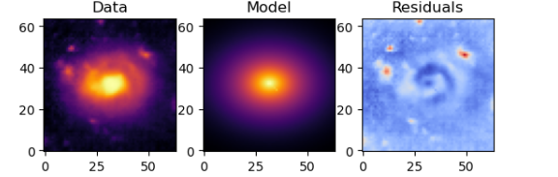
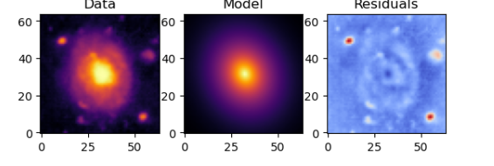
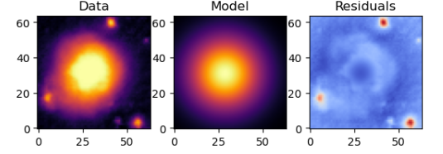
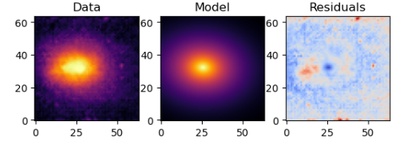
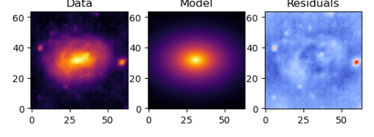
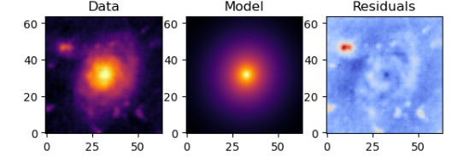
Sersic Model Model Fits!

Slide 9
Conclusion
Qualitatively, our GAN model did a good job of reproducing real galaxies. While it failed to capture more complex features, it was able to capture several distinct morphological types and produce images that generalized galaxy ight profiles very well
Quantitatively, it performed extremely well. Both the light and color profiles of the galaxies it produced match up with the training inputs within 3σ
Next steps include continuing to refine GAN architecture, experimenting with the applications of CNN networks to evaluate discriminator and generator accuracy, and more robust galactic analysis.

